Slide 1

Department of Computer Science and Engineering
ANALYSIS AND PREDICTION OF COVID-19 USING TIME SERIES FORECASTING
Date: 27 May 2021
Padmasree Alagam : 17wh1a05a3
Talluri Kavya : 17wh1a0571
Santhoshi Kukkadapu : 17wh1a0587
Internal Guide : Dr. K. Srinivasa Reddy
Designation : Head of the Department,CSE

Slide 2

Abstract
Why Should I Study this course?
This project focuses on the data analytics for the available data for COVID-19 pandemic disease. In this project, python and its libraries are applied for the exploratory data analysis of the dataset. Considering the variation of the scenario with time, it has been observed to analyze the data with the time series analysis in order to forecast the future effect of corona virus globally. This analysis has been conducted using six methods,viz. AR, MA, SVM, FB Prophet, Holt's linear trend method, Holt's Winter seasonal method and ARIMA model. Worldwide vaccination is also analyzed in this project for future forecasting of vaccination percentages of different countries.
Examples
BVRIT HYDERABAD College of Engineering for Women

Slide 3
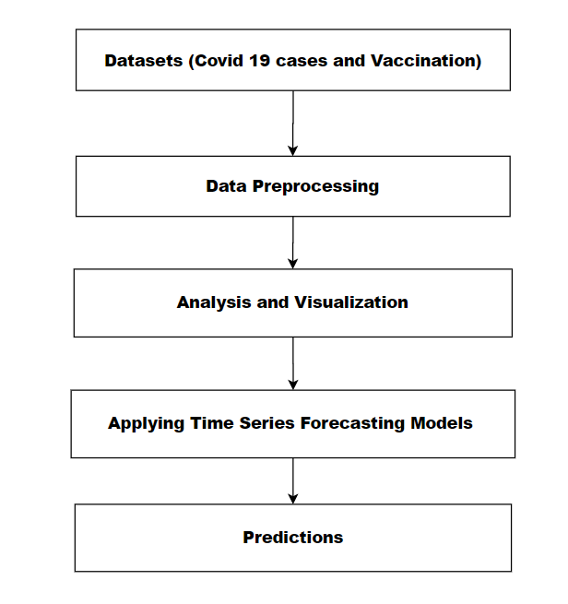
Design Architecture
Why Should I Study this course?
Examples
BVRIT HYDERABAD College of Engineering for Women

Slide 4
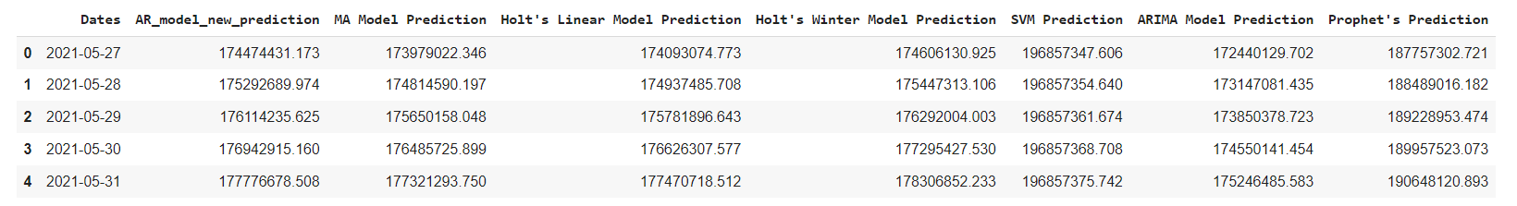
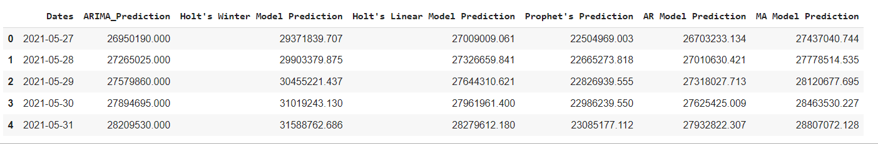
Output
Why Should I Study this course?
World wide Confirmed Cases Predictions
Examples
India Confirmed Cases Predictions
BVRIT HYDERABAD College of Engineering for Women

Slide 5
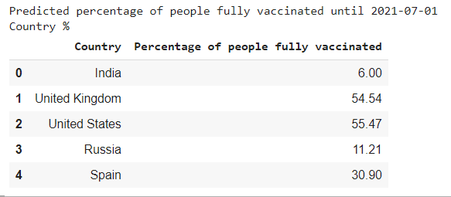
Output
Why Should I Study this course?
World wide Vaccination percentage Predictions
Examples
BVRIT HYDERABAD College of Engineering for Women

Slide 6
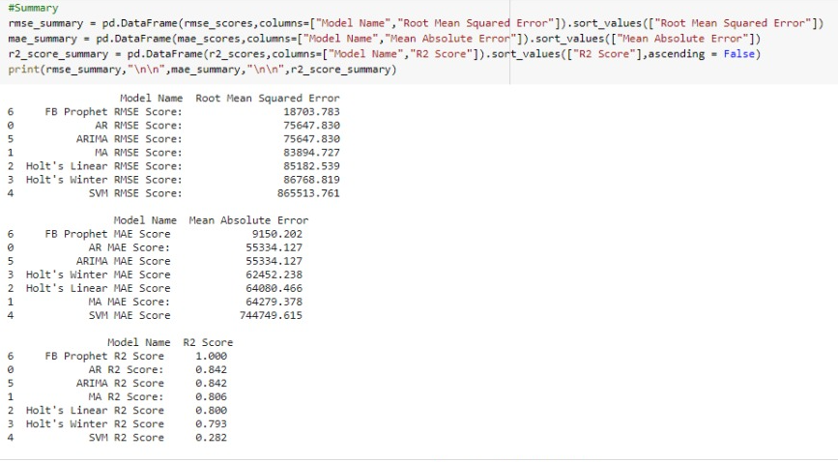
Why Should I Study this course?
Performance Metrics
Examples
BVRIT HYDERABAD College of Engineering for Women

Slide 7
THANK YOU

